Slide 1
CS4135 – Windows Communication Foundation
Windows Communication Foundation ( WCF ),
a part of the .NET Framework that provides a unified programming model for rapidly building service-oriented applications that communicate across the web.

Slide 2
Terminology
Service contract
Interface to the service
Operation contract
Signatures defined within a Service contract
also known as endpoints for consumption later
Data contract
Complex types used within the contract / interface
Data member
Typically primitives, of a Data contract
Service implementation
implements the Service Contract

Slide 3
Getting started
Visual Studio 2010
Visual web developer component must be installed in order to complete this exercise
Internet Information Services (IIS) (optional)
Can be installed via ‘turn windows features on or off’
Make sure to select all sub components
Implementation will be done in C#, however it can be done in any of the .NET languages that support WCF

Slide 4
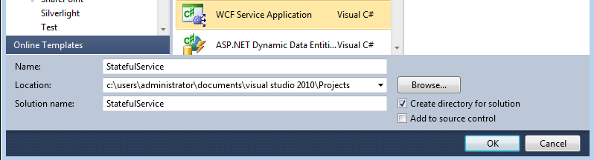
1. Creating a new project
Open Visual Studio
File -> New Project
Select WCF Service Application
Name it ‘StatefulService’ and click ok

Slide 5
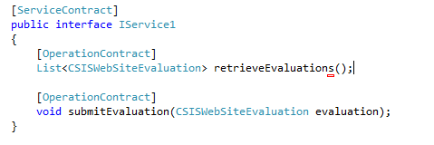
2. Defining your Service Contract
Visual studio will give a default example implementation, of both a Service Contract and a Contract implementation.
IService1.cs and Service1.svc.cs
Open the contract IService.cs from the solution explorer
Replace the current Operation Contracts in the Service Contract
Note* excluding the [OperationContract] annotation effectively means this will not be available to the client later on.

Slide 6
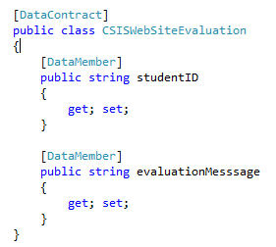
3. Defining your Data Contract
In the previous slide the return type and the argument type specify a Contractual Type, which we must define.
Below the Service Contract, is the definition of our Data Contract(s).
Lets define the Data Contract for ‘CSISWebSiteEvaluation’
Note* you can replace the Data Contract(s) provided by visual studio as we will not be using it.
Notice the annotations for [Data Contract] etc.

Slide 7
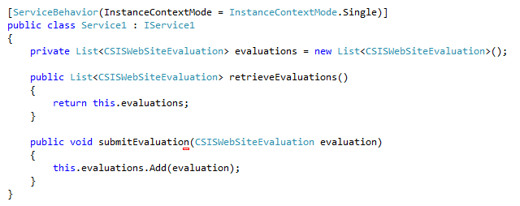
4. Implement your Service Contract
Open Service1.svc.cs
Remove the implementation that implemented the Contract we just replaced.
The annotation above the class name infers server side Singleton. IE. only one instance of this service will exist, no matter how many clients connect to it. Race conditions?

Slide 8
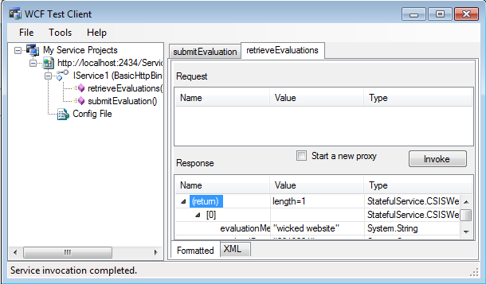
5. Test your implementation
Hit the Green Arrow to execute your service
Visual studio includes a test bed for your application, IE. it will host the service as a web service and expose the service to the web.
Visual studio also has a WCF Test Client,
You can test the operations exposed by the server by invoke them respectively.

Slide 9
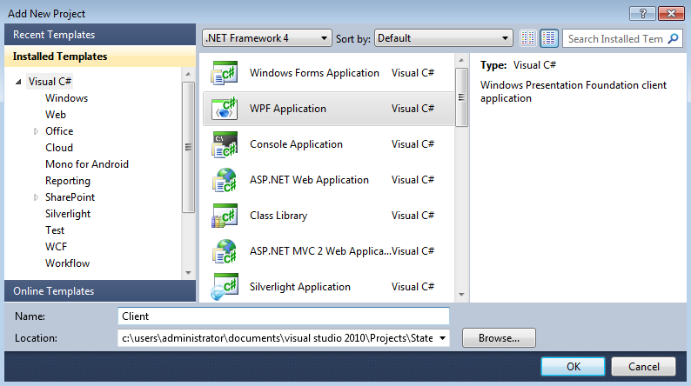
6. Building a client
In the solution explorer, right click the solution and select ‘add‘ -> ‘new project’
Select WPF ( window presentation foundation ) and name your project ‘Client’.

Slide 10
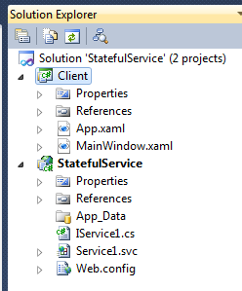
7. Your solution
Your solution should now have 2 projects
StatefulService
Client

Slide 11
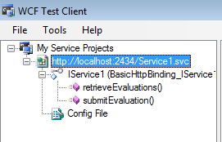
8. Reference your service
In order to subscribe to the service we must copy the URL from which it is exposed.
Right click the location in the WCF Test client seen earlier, and select ‘copy address’

Slide 12
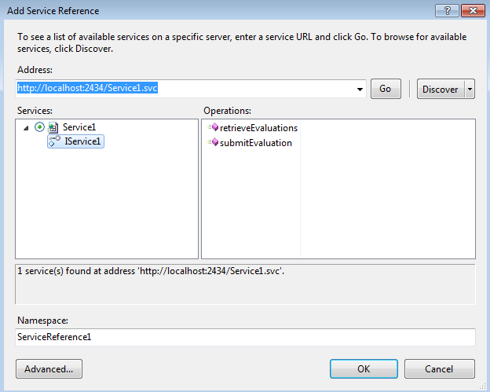
7. Client Project
Now right click the Client project and select ‘add service reference’
Paste the URL into the Address bar and click ‘go’

Slide 13
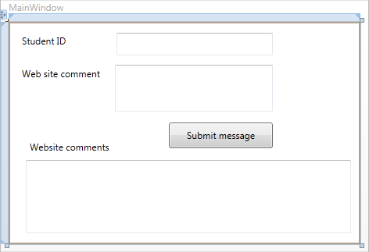
8. Draw your window
Using the ’Label’ ‘TextBox’ and ‘Button’ Controls from the toolbox.
Draw a window like so

Slide 14
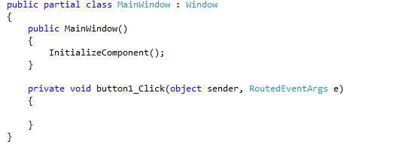
9. Button click Event Handler
To create a button click event handler, simply double click the button and visual studio will create an event handler for the click event

Slide 15

10. Using the Service namespace
To use the StatefulService we must include the namespace it exposes
This namespace is provided by the Service Reference we added earlier.
This namespace provides access to the definitions of the Contractual Types used in the StatefulService, also it will provide ‘ Service1Client’ which will be used to connect to the StatefulService.

Slide 16
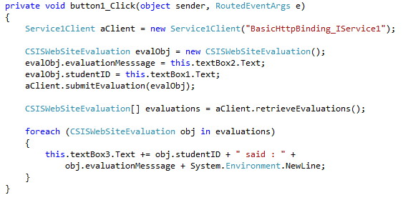
11. Implement the connection

Slide 17
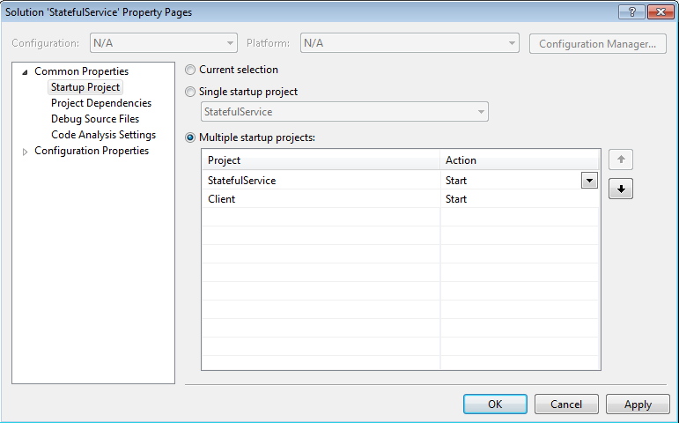
12. Building and testing
Confirm your application builds.
From the Build menu select ‘build solution’
We need to start both project at the same time, so we need to modify the strart up project procedure.
In the solution explorer right click the solution and select ‘set Startup projects’
Select ‘multiple startup projects’, set the actions to ‘start’ and put the ‘Stateful service’ First.
HIT The Green Arrow!

Slide 18
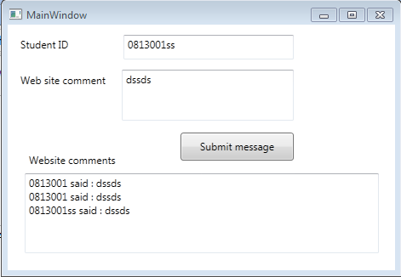
13. In action

Slide 19
12. Video Resources
http://msdn.microsoft.com/en-us/netframework/dd939784
Creating your first WCF Service
Configuring Services with endpoints
Hosting Services on IIS
Self Hosting WCF Services
Creating your first WCF client
Configuring WCF Service References

